Slide 1
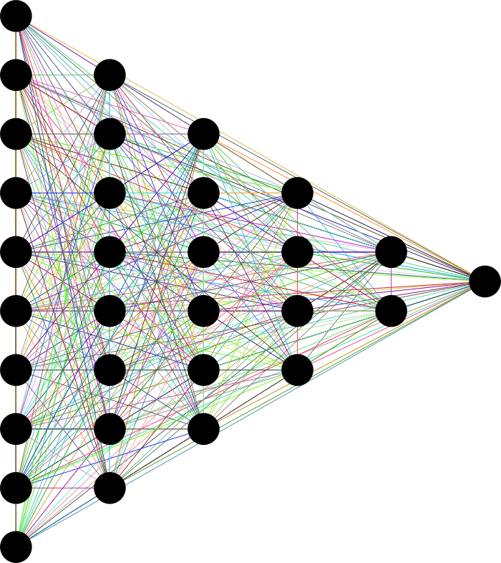

DIABETES RISK PROTECTION
GROUP 13
JOSEP MONTORO
SILVIA ANDREEVA
ARTEMIS MAIGNE
ARTHUR BELLOC
MACHINE LEARNING 1
GROUP PROJECT
1
Notes:
And I will do the presentation of our Machine Learning project proposal that in our case is about Diabetes RIsk Protection and we want to Create and evaluate a machine learning model that would be able to predict the diabetes risk using health and lifestyle indicators.

Slide 2
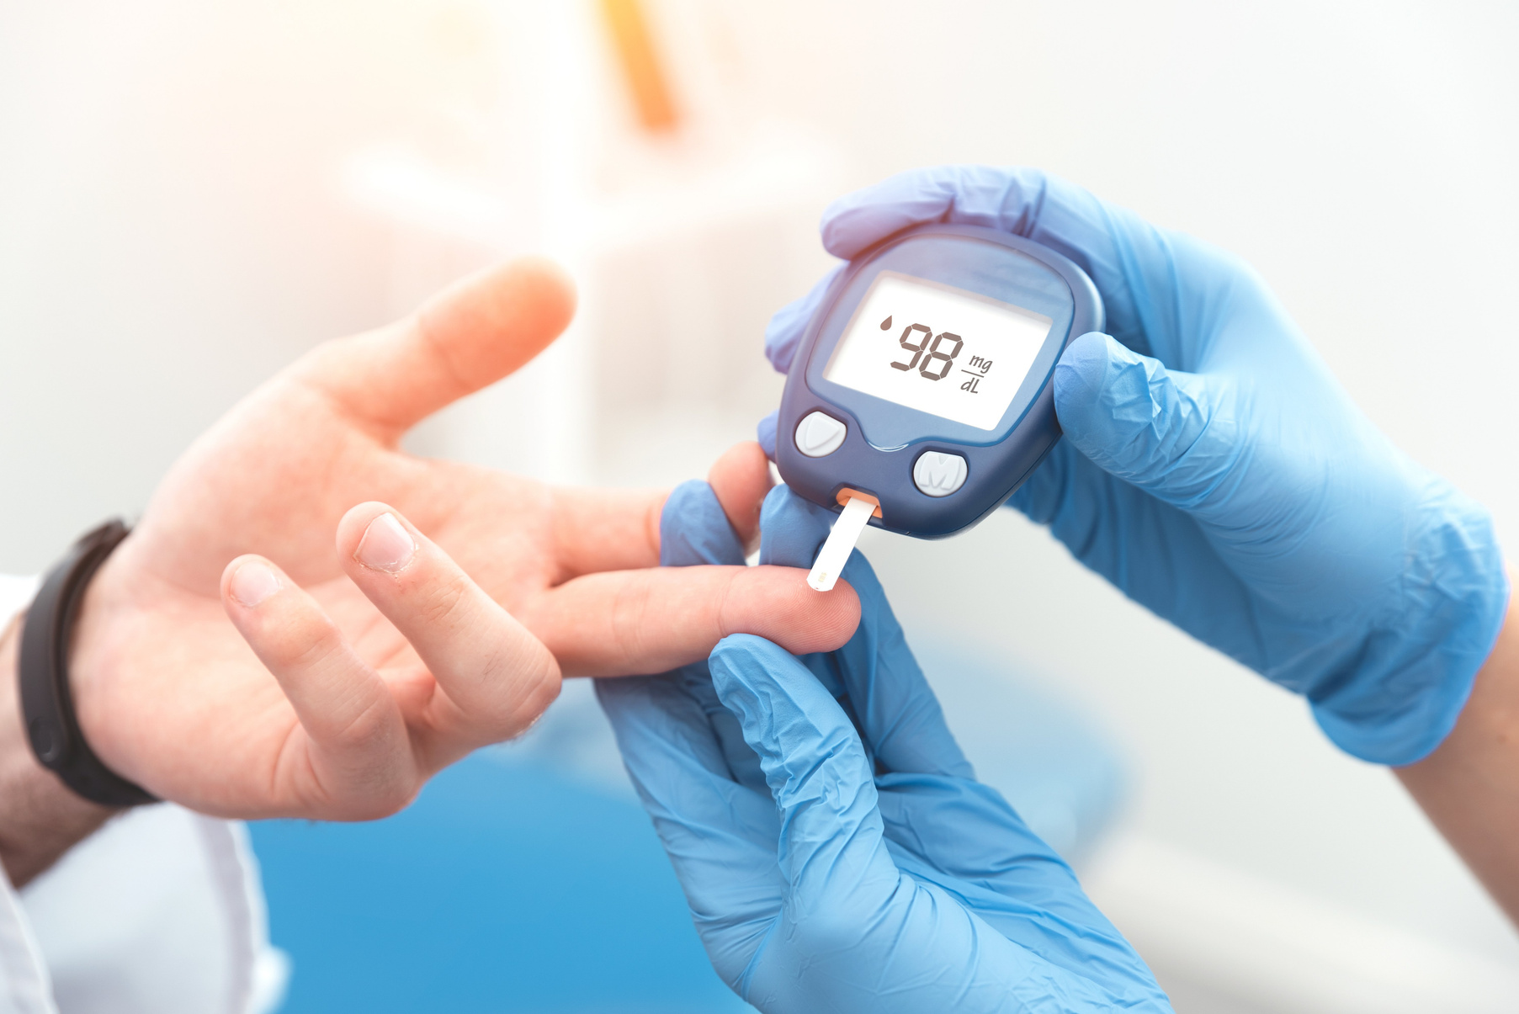
DIABETES :
A GLOBAL CHALLENGE
537M
2
3
Diagnosed people worldwide
Main
Reasons
Major Consequences
Glucose is the most important source of energy to the body.
It requires insulin to reach its target cells.
Without enought insulin, glucose accumulates in the blood, causing prolonged hyperglycemia.
1 - The pancreas does not produce enough (or any) insulin.
2 - The body is not properly responding to insulin’s effects.
1 - Cardiovascular issues
2 - Nerve damages
3 - Retinopathy
2
Notes:
Diabetes is a condition that is common among people of different stages of life. There are around 537 million diagnosed people worldwide, and experts predict that the number shall continue to rise in the future. It is a condition that occurs when your blood sugar level is too high. It develops when the person’s pancreas isn’t making enough insulin(or any) or when the person’s body isn’t properly responding to insulin’s effects. For glucose, which is the most important source of energy for the body, to reach its final destination it needs insulin, and if the body isn’t using the hormone correctly, the glucose builds up in the bloodsteam, which causes high blood sugar(hyperglycemia). High blood sugar over prolonged time could cause other health problems such as cardiovascular issues, nerve damage, and eye issues. Diabetes, in most cases, is a chronic disease, but it can be managed with medications and/or changes to one’s lifestyle.

Slide 3
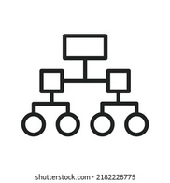
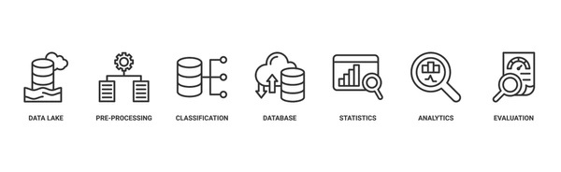

PROJECT
OBJECTIVES
Binary Classification
Comparative Evaluation
Build binary classification models that are able to predict if a person has or doesn’t have diabetes
Compare different machine learning models to find the best model based on our goals.
Impact Analysis
Key Factors
Assess the health impact of misclassification.
False Negatives : delay of the treatment
False Positives : unnecessary stress and expenses
We strive to identify which are the key risk factors that contribute to diabetes.
3
Notes:
Build binary classification models that are able to predict if a person has or doesn’t have diabetes. Create, evaluate, and compare different machine learning models to find the best model based on our goals. We want to assess the health impact of misclassification as false negatives will delay the treatment of a patient, while false positive could cause unnecessary stress both mentally and finantially. This impact will be incorporated into model selection. We also strive to identify which are the key risk factors that contribute to diabetes.

Slide 4
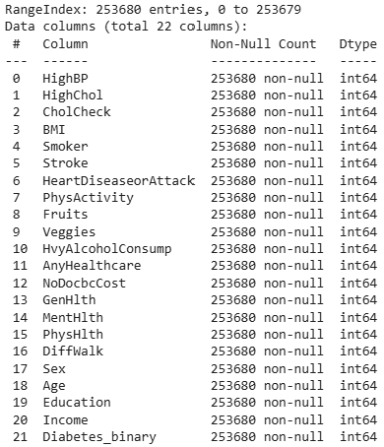
DATA CLEANING AND PREPROCESSING
DATA CLEANING:
  Check the target distribution
  Check the duplicates
  Check missing values
PREPROCESSING:
1) Stratified split
2) 80% training data and 20% testing data
3) random_state = 42
4
Notes:
The dataset we have chosen is the CDC Diabetes Health Indicators Dataset that contains both healthcare statistics and lifestyle information about people and their diagnosis of diabetes. There are 253k instances with 21 features including BMI, High Cholesterol, Smoker, Income, Age, Sex. Most variables are binary variables with a few being integer, and there are no missing values.

Slide 5
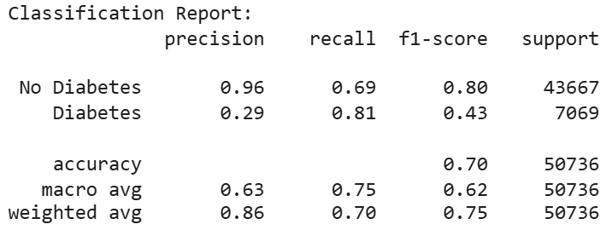
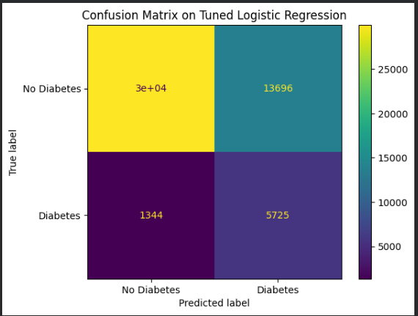
LOGISTIC REGRESSION
The easiest model to implement
3 WAYS OF IMPLEMENTING IT:
  A Normal Logistic Regression
  A Balanced Logistic regression
  A Tuned Logistic Regression
EXPLAINING THE TUNING :
1) Minimising the false negatives as much as possible
2) Having the best recall on the true positives
3) Improving the overall accuracy
PARAMETERS:
L2 penalty, balanced class weight, liblinear solver, strong regularization of 0.001, and threshold of 0.46
5
Notes:
The dataset we have chosen is the CDC Diabetes Health Indicators Dataset that contains both healthcare statistics and lifestyle information about people and their diagnosis of diabetes. There are 253k instances with 21 features including BMI, High Cholesterol, Smoker, Income, Age, Sex. Most variables are binary variables with a few being integer, and there are no missing values.

Slide 6
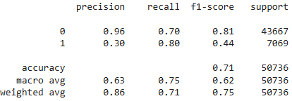
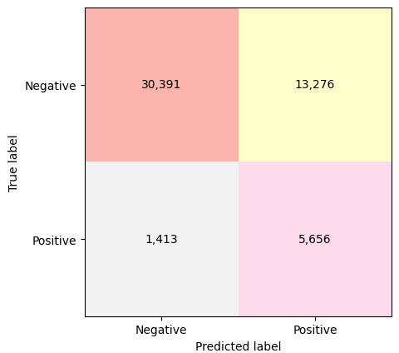
RANDOM FOREST
WHY RANDOM FOREST?
  capture nonlinear relationships
  robust to overfitting
FINETUNING:
  RandomizedSearchCV for best hyperparameters
  Threshold Optimization for Recall
BEST PARAMETERS:
n_estimators: 400, min_samples_split: 2, min_samples_leaf: 10, max_depth: 10, class_weight: balanced, and threshold: 0.4764
6
Notes:
Our methodology starts with data preprocessing and visualization. First, we will check the distribution of the different classes(diabetes, no diabetes).
Then, we will look into how each feature is distributed based on the different classes. Lastly, we can check the correlation between the different features using a heatmap.
The next step would be to deal with the class imbalance. There are three main ways to do this, which are resampling, class weight, and synthetic data generation.
We will decide which is best to use once we explore the dataset more.
After that, some features may need scaling, and we will need to remove extreme outliers.
Lastly, we will split the dataset into training and testing data with stratification so that the class distribution is preserved in both the train and test sets.
Next, we will discuss the models that we plan to create. Firstly, we will start with logistic regression, and this will be our baseline model.
Next, we will do random forest model that should help us capture nonlinear relationships within our data, and it should be robust to overfitting.
The third model will be Gradient Boosting, which, in general, is good for mixed variable types. It also tends to outperform other algorithms on complex data, be robust, and does feature selection. Lastly, we will implement a neural network model, more specifically an MLP model, to capture nonlinear relationships. Our dataset is structured and has predominantly binary features, hence, gradient boosting should perform better without requiring feature scaling and involve less complex tuning compared to neural networks. However, we still want to explore different types of models and evaluate how well MLP will perform relative to the more traditional methods above.
The next step would be evaluation, where we will look into different performance metrics such as accuracy, precision, recall, and ROC AUC(Receiver Operating Characteristic - Area Under Curve). As we are dealing with medical diagnosis, misclassification can have significant consequences. Our models should prioritize higher recall, as False Negatives could mean delaying treatment and worsening a patient’s condition.
The last step of our methodology is model explainability. Here, we will use SHAP(Shapley Additive Explanations), which should help us to identify the most influential features, meaning we will understand which health and lifestyle factors contribute most to the predicted risk of diabetes.

Slide 7
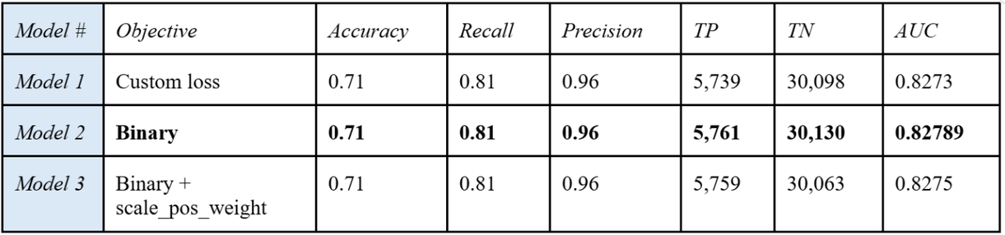
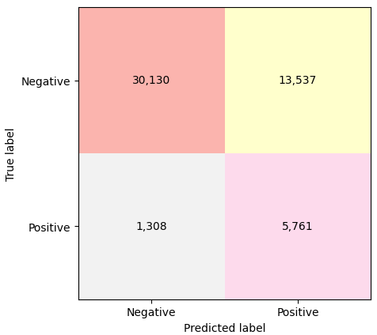
GRADIENT BOOSTING
WHY LIGHTGBM?
  A Tree-based algorithm for large datasets
  Handles non-linear interactions
  Tune decision threshold after probability output
THREE DIFFERENT MODELS
  Gradient Boosting with a custom loss function
  Gradient Boosting with binary logistic objective
  Balanced Gradient Boosting with binary logistic objective
FINETUNING:
  RandomizedSearchCV for best hyperparameters
  Threshold Optimization for Recall
BEST PARAMETERS:
num_leaves: 15, n_estimators: 500, min_child_samples: 20, learning_rate: 0.05, lambda_l2: 1, lambda_l1: 1, feature_fraction: 0.6, bagging_fraction: 0.8, and threshold: -1.92
7
Notes:
Our methodology starts with data preprocessing and visualization. First, we will check the distribution of the different classes(diabetes, no diabetes).
Then, we will look into how each feature is distributed based on the different classes. Lastly, we can check the correlation between the different features using a heatmap.
The next step would be to deal with the class imbalance. There are three main ways to do this, which are resampling, class weight, and synthetic data generation.
We will decide which is best to use once we explore the dataset more.
After that, some features may need scaling, and we will need to remove extreme outliers.
Lastly, we will split the dataset into training and testing data with stratification so that the class distribution is preserved in both the train and test sets.
Next, we will discuss the models that we plan to create. Firstly, we will start with logistic regression, and this will be our baseline model.
Next, we will do random forest model that should help us capture nonlinear relationships within our data, and it should be robust to overfitting.
The third model will be Gradient Boosting, which, in general, is good for mixed variable types. It also tends to outperform other algorithms on complex data, be robust, and does feature selection. Lastly, we will implement a neural network model, more specifically an MLP model, to capture nonlinear relationships. Our dataset is structured and has predominantly binary features, hence, gradient boosting should perform better without requiring feature scaling and involve less complex tuning compared to neural networks. However, we still want to explore different types of models and evaluate how well MLP will perform relative to the more traditional methods above.
The next step would be evaluation, where we will look into different performance metrics such as accuracy, precision, recall, and ROC AUC(Receiver Operating Characteristic - Area Under Curve). As we are dealing with medical diagnosis, misclassification can have significant consequences. Our models should prioritize higher recall, as False Negatives could mean delaying treatment and worsening a patient’s condition.
The last step of our methodology is model explainability. Here, we will use SHAP(Shapley Additive Explanations), which should help us to identify the most influential features, meaning we will understand which health and lifestyle factors contribute most to the predicted risk of diabetes.

Slide 8
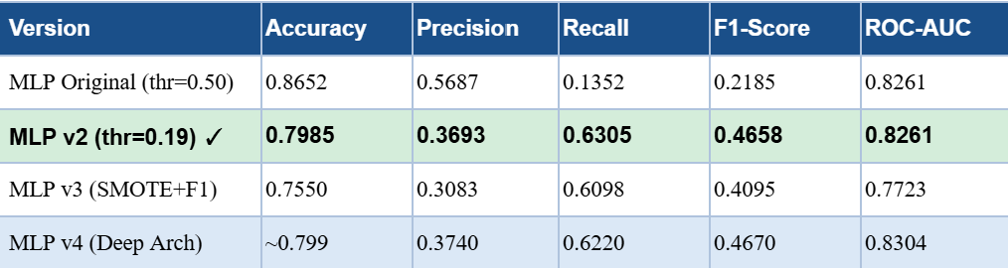
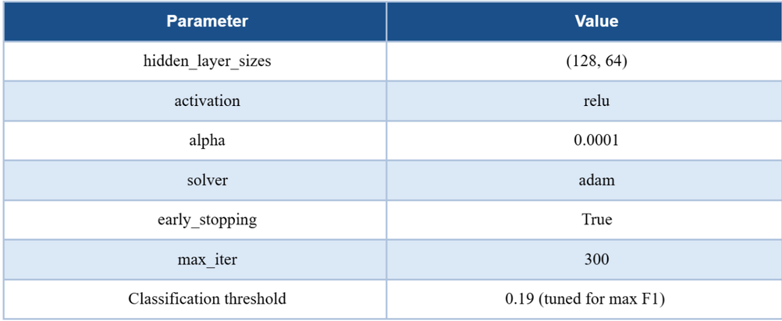
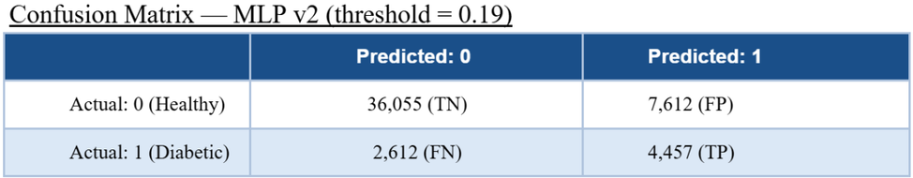
MLP NEURAL NETWORK
4 VERSIONS TO FIND THE BEST MODEL
  v1 : Original model trained with GridSearchCV
  v2 : v1 architechture with an f1 threshold tuning
  v3 : SMOTE with an f1 scoring
  v4 : Deepest architechture search possible
THRESHOLD CALIBRATION IS DECISIVE
The version 1 did not perform well at threshold 0.50 (6113 of 7069 diabetic patient missed). Therefore lowering the threshold to 0.19 convert this discriminative bias into an usable recall.
8
Notes:
Our methodology starts with data preprocessing and visualization. First, we will check the distribution of the different classes(diabetes, no diabetes).
Then, we will look into how each feature is distributed based on the different classes. Lastly, we can check the correlation between the different features using a heatmap.
The next step would be to deal with the class imbalance. There are three main ways to do this, which are resampling, class weight, and synthetic data generation.
We will decide which is best to use once we explore the dataset more.
After that, some features may need scaling, and we will need to remove extreme outliers.
Lastly, we will split the dataset into training and testing data with stratification so that the class distribution is preserved in both the train and test sets.
Next, we will discuss the models that we plan to create. Firstly, we will start with logistic regression, and this will be our baseline model.
Next, we will do random forest model that should help us capture nonlinear relationships within our data, and it should be robust to overfitting.
The third model will be Gradient Boosting, which, in general, is good for mixed variable types. It also tends to outperform other algorithms on complex data, be robust, and does feature selection. Lastly, we will implement a neural network model, more specifically an MLP model, to capture nonlinear relationships. Our dataset is structured and has predominantly binary features, hence, gradient boosting should perform better without requiring feature scaling and involve less complex tuning compared to neural networks. However, we still want to explore different types of models and evaluate how well MLP will perform relative to the more traditional methods above.
The next step would be evaluation, where we will look into different performance metrics such as accuracy, precision, recall, and ROC AUC(Receiver Operating Characteristic - Area Under Curve). As we are dealing with medical diagnosis, misclassification can have significant consequences. Our models should prioritize higher recall, as False Negatives could mean delaying treatment and worsening a patient’s condition.
The last step of our methodology is model explainability. Here, we will use SHAP(Shapley Additive Explanations), which should help us to identify the most influential features, meaning we will understand which health and lifestyle factors contribute most to the predicted risk of diabetes.

Slide 9
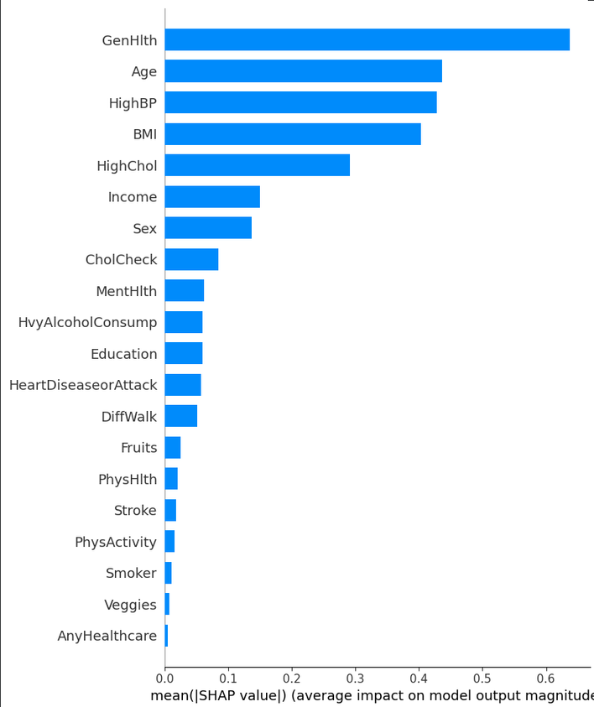
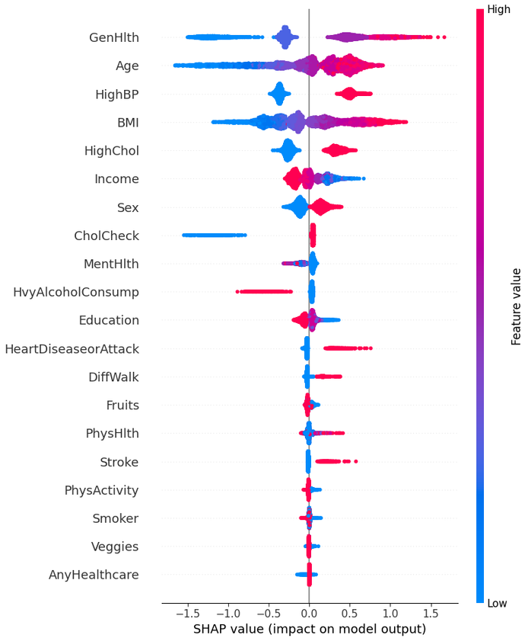
SHAP ANALYSIS
Most significant features for Prediction:
  General Health score
  High Blood Pressure
  High Cholesterol
  Age
  BMI
How does each parameter affect the possibility of a positive prediction?
  high value of general health
  high blood pressure
  older age
  higher BMI
  high cholesterol
  being a man
9

Slide 10
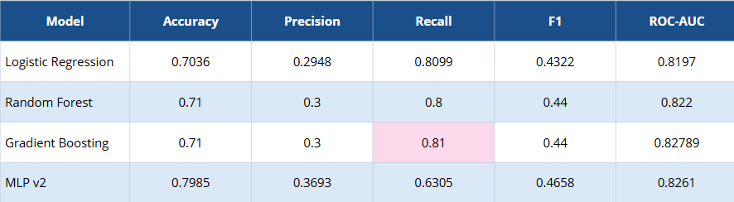
MODEL COMPARAISON
  Gradient Boosting and Logistic Regression achieved the highest Recall - 0.81 and maintained 71% overall accuracy
  All the models demonstrate strong discriminatory ability: AUC ≈ 0.82.
  Complex models did not significantly outperform Logistic Regression
  Less extensive hyperparameter search due to computational cost
  The feature set limits discrimination performance
10
Notes:
Our methodology starts with data preprocessing and visualization. First, we will check the distribution of the different classes(diabetes, no diabetes).
Then, we will look into how each feature is distributed based on the different classes. Lastly, we can check the correlation between the different features using a heatmap.
The next step would be to deal with the class imbalance. There are three main ways to do this, which are resampling, class weight, and synthetic data generation.
We will decide which is best to use once we explore the dataset more.
After that, some features may need scaling, and we will need to remove extreme outliers.
Lastly, we will split the dataset into training and testing data with stratification so that the class distribution is preserved in both the train and test sets.
Next, we will discuss the models that we plan to create. Firstly, we will start with logistic regression, and this will be our baseline model.
Next, we will do random forest model that should help us capture nonlinear relationships within our data, and it should be robust to overfitting.
The third model will be Gradient Boosting, which, in general, is good for mixed variable types. It also tends to outperform other algorithms on complex data, be robust, and does feature selection. Lastly, we will implement a neural network model, more specifically an MLP model, to capture nonlinear relationships. Our dataset is structured and has predominantly binary features, hence, gradient boosting should perform better without requiring feature scaling and involve less complex tuning compared to neural networks. However, we still want to explore different types of models and evaluate how well MLP will perform relative to the more traditional methods above.
The next step would be evaluation, where we will look into different performance metrics such as accuracy, precision, recall, and ROC AUC(Receiver Operating Characteristic - Area Under Curve). As we are dealing with medical diagnosis, misclassification can have significant consequences. Our models should prioritize higher recall, as False Negatives could mean delaying treatment and worsening a patient’s condition.
The last step of our methodology is model explainability. Here, we will use SHAP(Shapley Additive Explanations), which should help us to identify the most influential features, meaning we will understand which health and lifestyle factors contribute most to the predicted risk of diabetes.

Slide 11
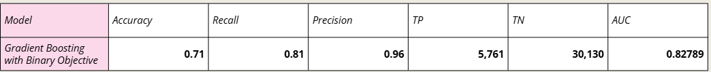
CONCLUSION
BEST MODEL:
Gradient Boosting with Binary Logistic Objective
REASONING:
  Marginally higher AUC
  Highest number of True Positives
  Good overall accuracy
11

Slide 12
THANK YOU FOR YOUR ATTENTION
ANY QUESTIONS?
12

